Slide 1
Java Script
By Vivek Gohil

Slide 2
Content
Getting Started

Slide 3
Getting Started
What is JavaScript?
How to Install a JavaScript source editor?
How to use console tab and Web Development Tools?
JavaScript Hello World

Slide 4
What is JavaScript?
JavaScript is a programming language initially designed to interact with elements of web pages.
In web browsers, JavaScript consist of three main parts:
ECMAScript : Which provides the core functionality.
The Document Object Model (DOM) provides interfaces for interacting with elements on web pages.
The Browser Object Model (BOM) provides the browser API for interacting with the web browser.

Slide 5
Client-side vs. Server-side JavaScript
JavaScript is used on a web page, it is executed in the users’ web browsers. In this case, JavaScript works as a client-side language.
A popular JavaScript server-side environment is Node.js. Unlike client-side JavaScript, server-side JavaScript executes on the server that allows you to access databases, file systems, etc.

Slide 6
How to Install a JavaScript source editor?
To edit JavaScript source code, basically, you just need a plain text editor such as Notepad on Windows.
Some editors also provide a convenient way to debug JavaScript and other tools relevant to the software development process.
The following are some popular JavaScript code editors:
Visual Studio Code
Atom
Notepad++

Slide 7
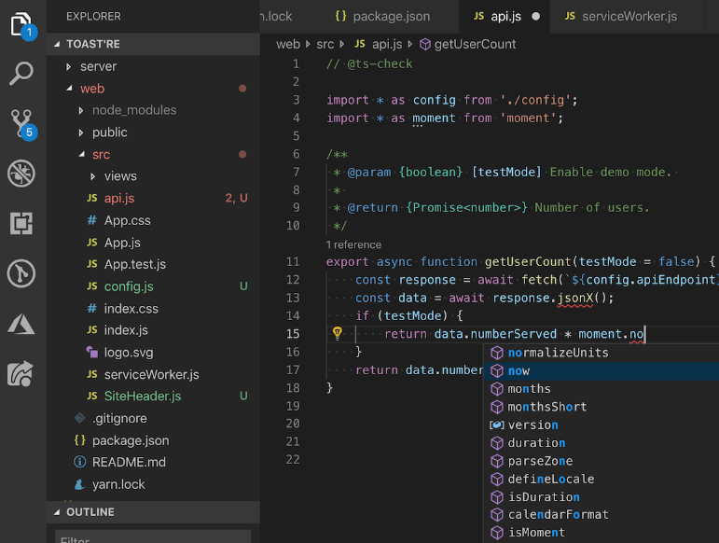
Visual Studio Code
Visual Studio Code is a free and open-source code editor developed by Microsoft. Visual Studio Code is often called VS Code.
Download Visual Studio Code
https://code.visualstudio.com/download

Slide 8
How to use console tab and Web Development Tools?
Web development tools allow you to test and debug the JavaScript code. Web development tools are often called devtools.
Modern web browsers such as Google Chrome, Firefox, Edge, Safari, and Opera provide the devtools as built-in features.

Slide 9
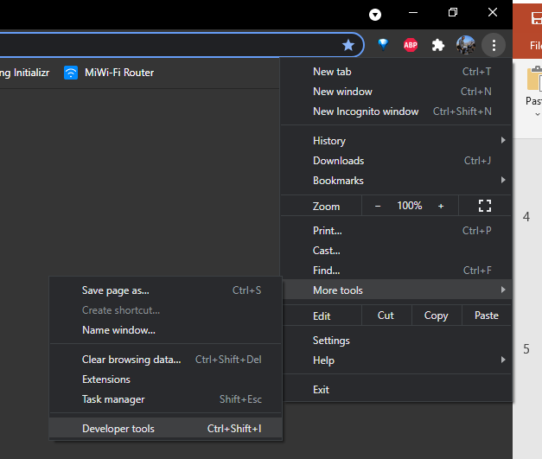
Google Chrome Web Developer Tools

Slide 10
JavaScript Hello World Example
To insert JavaScript into an HTML page, you use the <script> element. There are two ways to use the <script> element in an HTML page:
Embed JavaScript code directly into the HTML page.
Reference an external JavaScript code file.

Slide 11
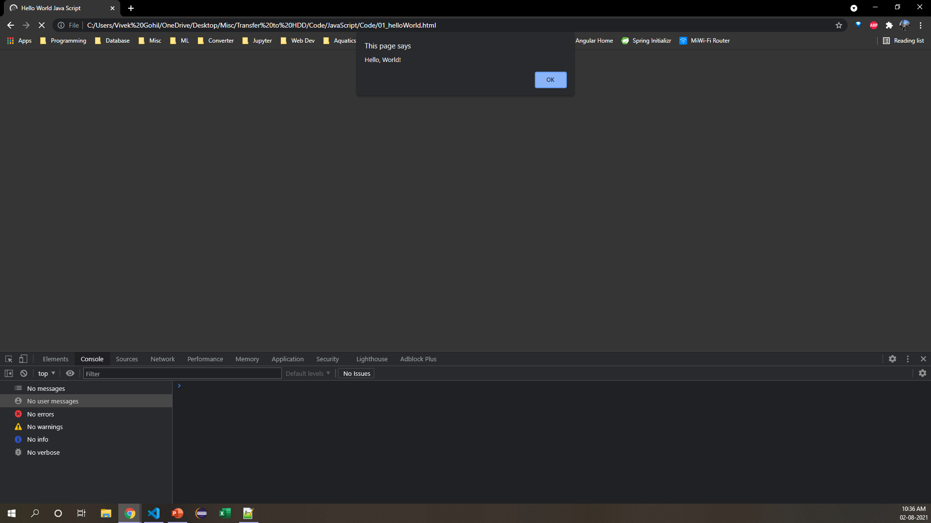
Embed JavaScript code in an HTML page
Placing JavaScript code inside the <script> element directly is not recommended and should be used only for proof of concept or testing purposes.
<!DOCTYPE html>
<html>
<head>
<meta charset='utf-8'>
<meta http-equiv='X-UA-Compatible' content='IE=edge'>
<title>Hello World Java Script</title>
<script>
alert('Hello, World!');
</script>
</head>
<body>
</body>
</html>

Slide 12
Include an external JavaScript file
helloworld.html
app.js
<!DOCTYPE html>
<html lang="en">
<head>
<meta charset="UTF-8">
<title>JavaScript Hello World Example</title>
<script src="app.js"></script>
</head>
<body>
</body>
</html>
alert('Hello, World!');

Slide 13
Using JavaScript
Change the HTML Content Using JavaScript
<!DOCTYPE html>
<html>
<head>
<meta charset='utf-8'>
<meta http-equiv='X-UA-Compatible' content='IE=edge'>
<title>Change HTML</title>
</head>
<body>
<p id="demo"></p>
<script>
document.getElementById("demo").innerHTML = "My First JavaScript";
</script>
</body>

Slide 14
Using JavaScript
Change HTML Content On Button Click
<!DOCTYPE html>
<html>
<head>
<meta charset='utf-8'>
<meta http-equiv='X-UA-Compatible' content='IE=edge'>
<title>Change Content</title>
<script>
function myFunction() {
document.getElementById("demo").innerHTML = "Paragraph changed.";
}
</script>
</head>
<body>
<h2>JavaScript in Head</h2>
<p id="demo">A Paragraph.</p>
<button type="button" onclick="myFunction()">Try it</button>
</body>
</html>

Slide 15
JavaScript Output
JavaScript can "display" data in different ways:
Writing into an HTML element, using innerHTML.
Writing into the HTML output using document.write().
Writing into an alert box, using window.alert().
Writing into the browser console, using console.log().

Slide 16
Using InnerHTML
<!DOCTYPE html>
<html>
<body>
<h1>My First Web Page</h1>
<p>My First Paragraph</p>
<p id="demo"></p>
<script>
document.getElementById("demo").innerHTML = 5 + 6;
</script>
</body>
</html>

Slide 17
Using document.write
Using document.write() after an HTML document is loaded, will delete all existing HTML:
The document.write() method should only be used for testing.
<!DOCTYPE html>
<html>
<body>
<h2>My First Web Page</h2>
<p>My first paragraph.</p>
<button type="button" onclick="document.write(5 + 6)">Try it</button>
</body>
</html>

Slide 18
Using Window.alert
<!DOCTYPE html>
<html>
<head>
<script>
window.alert(5 + 6);
</script>
</head>
<body>
<h2>My First Web Page</h2>
<p>My first paragraph.</p>
</body>
</html>

Slide 19
JavaScript Keywords
Keyword | Description
var | Declares a variable
let | Declares a block variable
const | Declares a block constant
if | Marks a block of statements to be executed on a condition
switch | Marks a block of statements to be executed in different cases
for | Marks a block of statements to be executed in a loop
function | Declares a function
return | Exits a function
try | Implements error handling to a block of statements

Slide 20
JavaScript Variables
There are 3 ways to declare a JavaScript variable:
Using var
Using let
Using const

Slide 21
Using var
<!DOCTYPE html>
<html>
<body>
<h2>JavaScript Variables</h2>
<p>In this example, x, y, and z are variables.</p>
<p id="demo"></p>
<script>
var x = 5;
var y = 6;
var z = x + y;
document.getElementById("demo").innerHTML =
"The value of z is: " + z;
</script>
</body>
</html>

Slide 22
Using let
Variables defined with let cannot be Redeclared.
Variables defined with let must be declared before use.
Variables defined with let have block scope.
<!DOCTYPE html>
<html>
<body>
<h2>Redeclaring a Variable Using var</h2>
<p id="demo"></p>
<script>
// var x = 10;
let x = 10;
// Here x is 10
{
let x = 2;
// var x = 2;
// Here x is 2
}
// Here x is 2
document.getElementById("demo").innerHTML = x;
</script>
</body>
</html>

Slide 23
Using Const
Variables defined with const cannot be redeclared.
Variables defined with const cannot be reassigned.
Variables defined with const have block scope.
<!DOCTYPE html>
<html>
<body>
<h2>JavaScript const</h2>
<p id="demo"></p>
<script>
try {
const PI = 3.141592653589793;
PI = 3.14;
}
catch (err) {
document.getElementById("demo").innerHTML = err;
}
</script>
</body>
</html>

Slide 24
JavaScript Operators
Arithmetic Operators
Assignment Operators
String Operators
Comparison Operators
Logical Operators
Type Operators
Bitwise Operators

Slide 25
Arithmetic Operators
Operator | Description
+ | Addition
- | Subtraction
* | Multiplication
** | Exponentiation
/ | Division
% | Modulus (Remainder)
++ | Increment
-- | Decrement

Slide 26
Assignment Operator
Operator | Example | Same As
= | x = y | x = y
+= | x += y | x = x + y
-= | x -= y | x = x - y
*= | x *= y | x = x * y
/= | x /= y | x = x / y
%= | x %= y | x = x % y
**= | x **= y | x = x ** y

Slide 27
Comparison Operators
Operator | Description
== | equal to
=== | equal value and equal type
!= | not equal
!== | not equal value or not equal type
> | greater than
< | less than
>= | greater than or equal to
<= | less than or equal to
? | ternary operator

Slide 28
Logical Operators
Operator | Description
&& | and
|| | or
! | not

Slide 29
Type Operators
Operator | Description
typeof | Returns the type of a variable
instanceof | Returns true if an object is an instance of an object type

Slide 30
Bitwise Operators
Operator | Description | Example | Same as | Result | Decimal
& | AND | 5 & 1 | 0101 & 0001 | 0001 | 1
| | OR | 5 | 1 | 0101 | 0001 | 0101 | 5
~ | NOT | ~ 5 | ~0101 | 1010 | 10
^ | XOR | 5 ^ 1 | 0101 ^ 0001 | 0100 | 4
<< | Zero fill left shift | 5 << 1 | 0101 << 1 | 1010 | 10
>> | Signed right shift | 5 >> 1 | 0101 >> 1 | 0010 | 2
>>> | Zero fill right shift | 5 >>> 1 | 0101 >>> 1 | 0010 | 2

Slide 31
JavaScript Data Types
JavaScript has dynamic types. JavaScript variables can hold different data types: numbers, strings , objects and more.
let length = 16; // Number let lastName = "Johnson"; // String let x = {firstName:"John", lastName:"Doe"}; // Object

Slide 32
JavaScript Functions
A JavaScript function is a block of code designed to perform a particular task.
A JavaScript function is executed when something invokes it(calls it).
<!DOCTYPE html>
<html>
<body>
<h2>JavaScript Functions</h2>
<p id="demo"></p>
<script>
document.getElementById("demo").innerHTML =
"The temperature is " + toCelsius(77) + " Celsius";
function toCelsius(fahrenheit) {
return (5 / 9) * (fahrenheit - 32);
}
</script>
</body>
</html>

Slide 33
JavaScript Events
An HTML event can be something the browser does, or something a user does.
Here are some examples of HTML events:
An HTML web page has finished loading
An HTML input field was changed
An HTML button was clicked

Slide 34
JavaScript Array
An array is a special variable, which can hold more than one value at a time.

Slide 35
JavaScript Date Objects
Date objects are created with the new Date() constructor.
<!DOCTYPE html>
<html>
<body>
<h1>
Year :: <span id="year"></span> Month :: <span id="month"></span> Day :: <span id="day"></span> Hours :: <span
id="hours"></span> Minutes :: <span id="minutes"></span>
</h1>
<script>
const d = new Date();
document.getElementById("year").innerHTML = d.getFullYear();
document.getElementById("month").innerHTML = d.getMonth() + 1;
document.getElementById("day").innerHTML = d.getDate();
document.getElementById("hours").innerHTML = d.getHours();
document.getElementById("minutes").innerHTML = d.getMinutes();
</script>
</body>
</html>

Slide 36
JavaScript Loops
for - loops through a block of code a number of times
for/in - loops through the properties of an object
for/of - loops through the values of an iterable object
while - loops through a block of code while a specified condition is true
do/while - also loops through a block of code while a specified condition is true

Slide 37
For loop
<!DOCTYPE html>
<html>
<body>
<h2>JavaScript For Loop</h2>
<p id="demo"></p>
<script>
const cars = ["BMW", "Volvo", "Saab", "Ford"];
let i, len, text;
for (i = 0, len = cars.length, text = ""; i < len; i++) {
text += cars[i] + "<br>";
}
document.getElementById("demo").innerHTML = text;
</script>
</body>
</html>

Slide 38
For In loop
The JavaScript for in statement loops through the properties of an Object.
<!DOCTYPE html>
<html>
<body> <h2>JavaScript For In Loop</h2>
<p>The for in statement loops through the properties of an object:</p>
For in Over Object<p id="demo1"></p> <script>
const person = { fname: "John", lname: "Doe", age: 25 };
let txt1 = "";
for (let x in person) {
txt1 += person[x] + " ";
}
document.getElementById("demo1").innerHTML = txt1; </script>
</body>
</html>

Slide 39
For of loop
<!DOCTYPE html>
<html>
<body>
<h2>JavaScript For Of Loop</h2>
<p>The for of statement loops through the values of an iterable object.</p>
<p id="demo"></p>
<script>
let language = "JavaScript";
let text = "";
for (let x of language) {
text += x + "<br>";
}
document.getElementById("demo").innerHTML = text;
</script>
</body>
</html>

Slide 40
Type of Operator
You can use the typeof operator to find the data type of a JavaScript variable.

Slide 41
JavaScript DOM Events
Mouse Events
Keyboard Events
Submit Event

Slide 42
Mouse Events
Onmouseover and onmouseout event
<!DOCTYPE html>
<html>
<body>
<h1 onmouseover="style.color='red'" onmouseout="style.color='black'">Mouse over this text</h1>
</body>
</html>

Slide 43
Mouse Events
<!DOCTYPE html>
<html>
<head>
<script>
function bigImg(x) {
x.style.height = "64px";
x.style.width = "64px";
}
function normalImg(x) {
x.style.height = "32px";
x.style.width = "32px";
}
</script>
</head>
<body>
<img onmouseover="bigImg(this)" onmouseout="normalImg(this)" border="0" src="smiley.gif" alt="Smiley" width="32" height="32">
<p>The function bigImg() is triggered when the user moves the mouse pointer over the image.</p>
<p>The function normalImg() is triggered when the mouse pointer is moved out of the image.</p>
</body>
</html>

Slide 44
Mouse Events
onmousedown and onmouseup
<!DOCTYPE html>
<html>
<head>
<script>
function myFunction(elmnt, clr) {
elmnt.style.color = clr;
}
</script>
</head>
<body>
<p onmousedown="myFunction(this,'red')" onmouseup="myFunction(this,'green')">
Click the text to change the color. A function, with parameters, is triggered when the mouse button is pressed down, and again, with other parameters, when the mouse button is released.
</p>
</body>
</html>

Slide 45
Keyboard Events
onkeyup
<!DOCTYPE html>
<html>
<head>
<script>
function whichButton(event) {
document.getElementById("demo").innerHTML = event.keyCode;
}
</script>
</head>
<body onkeyup="whichButton(event)">
<p><b>Note:</b> Make sure the right frame has focus when trying this example!</p>
<p>Click on this page, and press a key on your keyboard.</p>
<p id="demo"></p>
</body>
</html>

Slide 46
Keyboard Events
Onkeyup and onkeydown
<!DOCTYPE html>
<html>
<head>
<script>
function color(color) {
document.forms[0].myInput.style.background = color;
}
</script>
</head>
<body>
<form>
Write a message:<br>
<input
type="text"
onkeydown="color('yellow')"
onkeyup="color('white')"
name="myInput">
</form>
</body>
</html>

Slide 47
Submit Event
Onsubmit
<!DOCTYPE html>
<html>
<head>
<script>
function confirmInput() {
fname = document.forms[0].fname.value;
alert("Hello " + fname + "! You will now be redirected to www.google.com");
}
</script>
</head>
<body>
<form onsubmit="confirmInput()" action="https://www.google.com/">
Enter your name: <input id="fname" type="text" size="20">
<input type="submit">
</form>
</body>
</html>

